Slide 1
Comparison and Error Modeling of Velocity-Based Initial Orbit Determination Algorithms
Linyi “Tiger” Hou, Kevin Lohan, and Zachary R. Putnam
University of Illinois at Urbana-Champaign

Slide 2
Introduction
v2
v2
v1
v1
Velocity-based initial orbit determination (VIOD)
Uses only velocity vectors
Does not depend on the Deep Space Network
Little error analysis has been previously performed
No error models have been previously developed
t2
t2
t1
t1
t1
Gibbs’ Method
Gibbs’ Method
r2
r2
v3
r2
v3
Laplace’s Method
Laplace’s Method
r1
r1
r3
r1
r3
Lambert’s Method
Lambert’s Method
ϕ1
ϕ2
ϕ1
ϕ2
ϕ3
ϕ3
Velocity IOD
Velocity IOD

Slide 3
Outline
Overview of VIOD Algorithms (with proposed improvement)
Comparison of VIOD algorithms
Error Modeling for Hodograph-based VIOD
Validation of Error Model
Example: Predicting VIOD Error

Slide 4
The Orbit Hodograph
v3
v3
v2
v2
Δf
R
v1
v1
Central Body
Δf
c
O

Slide 5
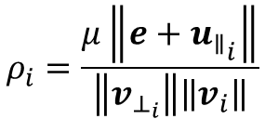
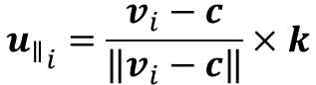
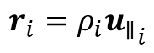
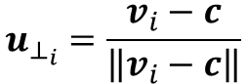
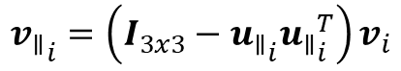
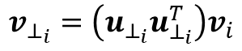
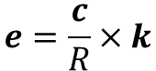
The Hodograph Method
Perform circle fit on velocity vectors to find hodograph
Find the orbit plane using singular value decomposition (SVD)
Project velocity vectors onto orbit plane
Perform 2D circle fit on projected velocity vectors
Retrieve position vectors from hodograph
$$e=\frac{c}{R}×k$$
$$u_{⊥_{i}}=\frac{v_{i}−c}{\left\|v_{i}−c\right\|}$$
$$v_{⊥_{i}}=\left(u_{⊥_{i}}u_{⊥_{i}}^{T}\right)v_{i}$$
$$ρ_{i}=\frac{μ\left\|e+{u_{∥}}_{i}\right\|}{\left\|v_{⊥_{i}}\right\|\left\|v_{i}\right\|}$$
$$r_{i}=ρ_{i}{u_{∥}}_{i}$$
$${u_{∥}}_{i}=\frac{v_{i}−c}{\left\|v_{i}−c\right\|}×k$$
$${v_{∥}}_{i}=\left(I_{3x3}−{u_{∥}}_{i}{u_{∥}}_{i}^{T}\right)v_{i}$$

Slide 6
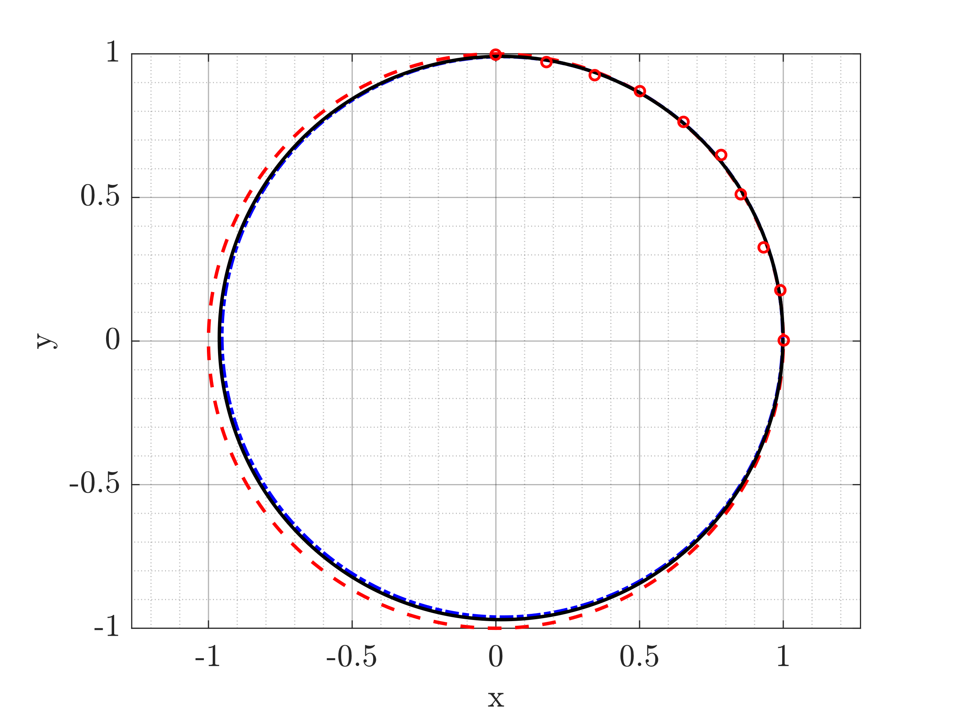
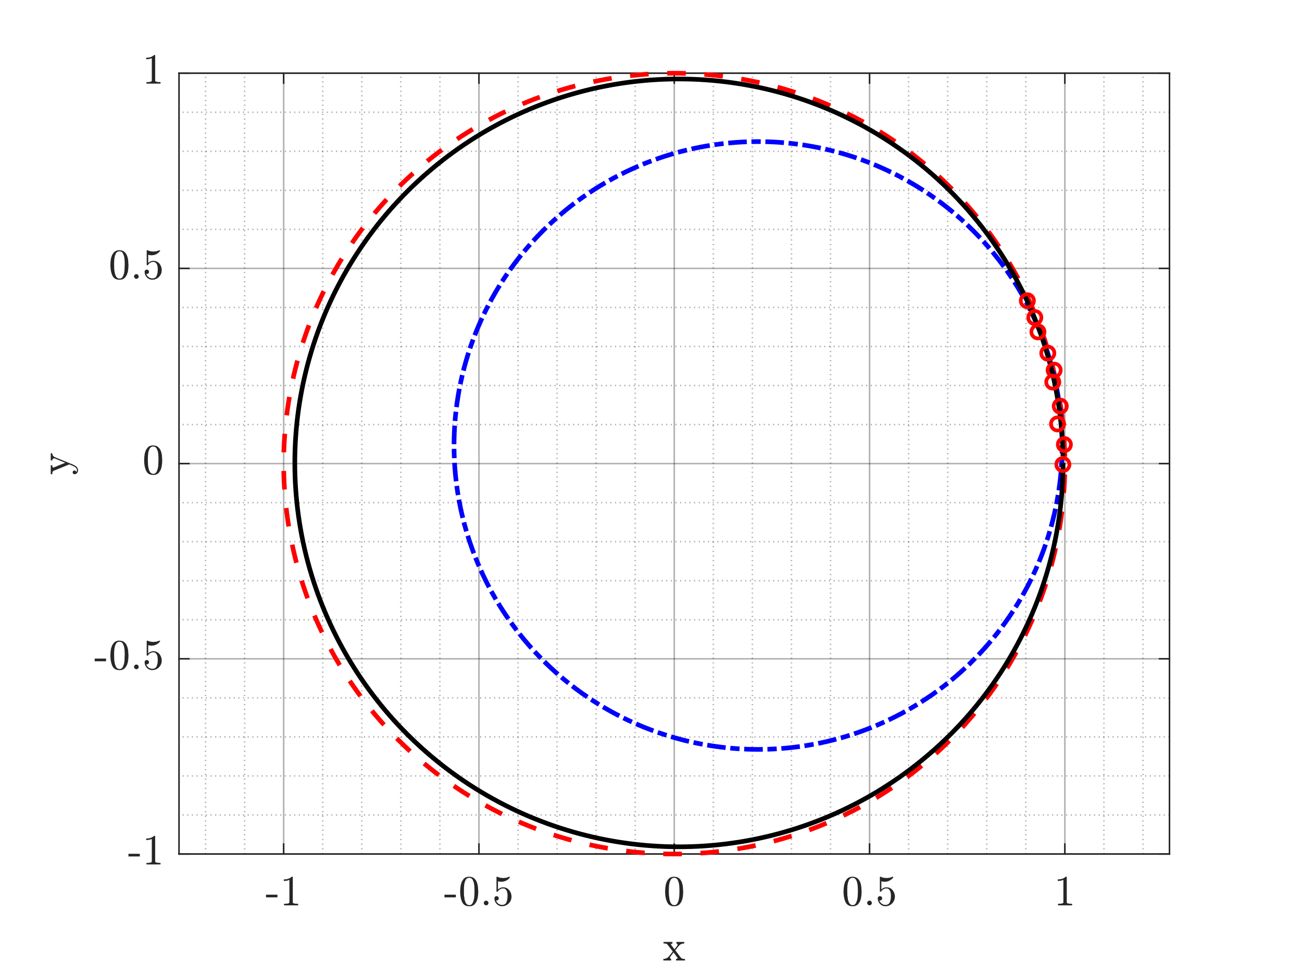
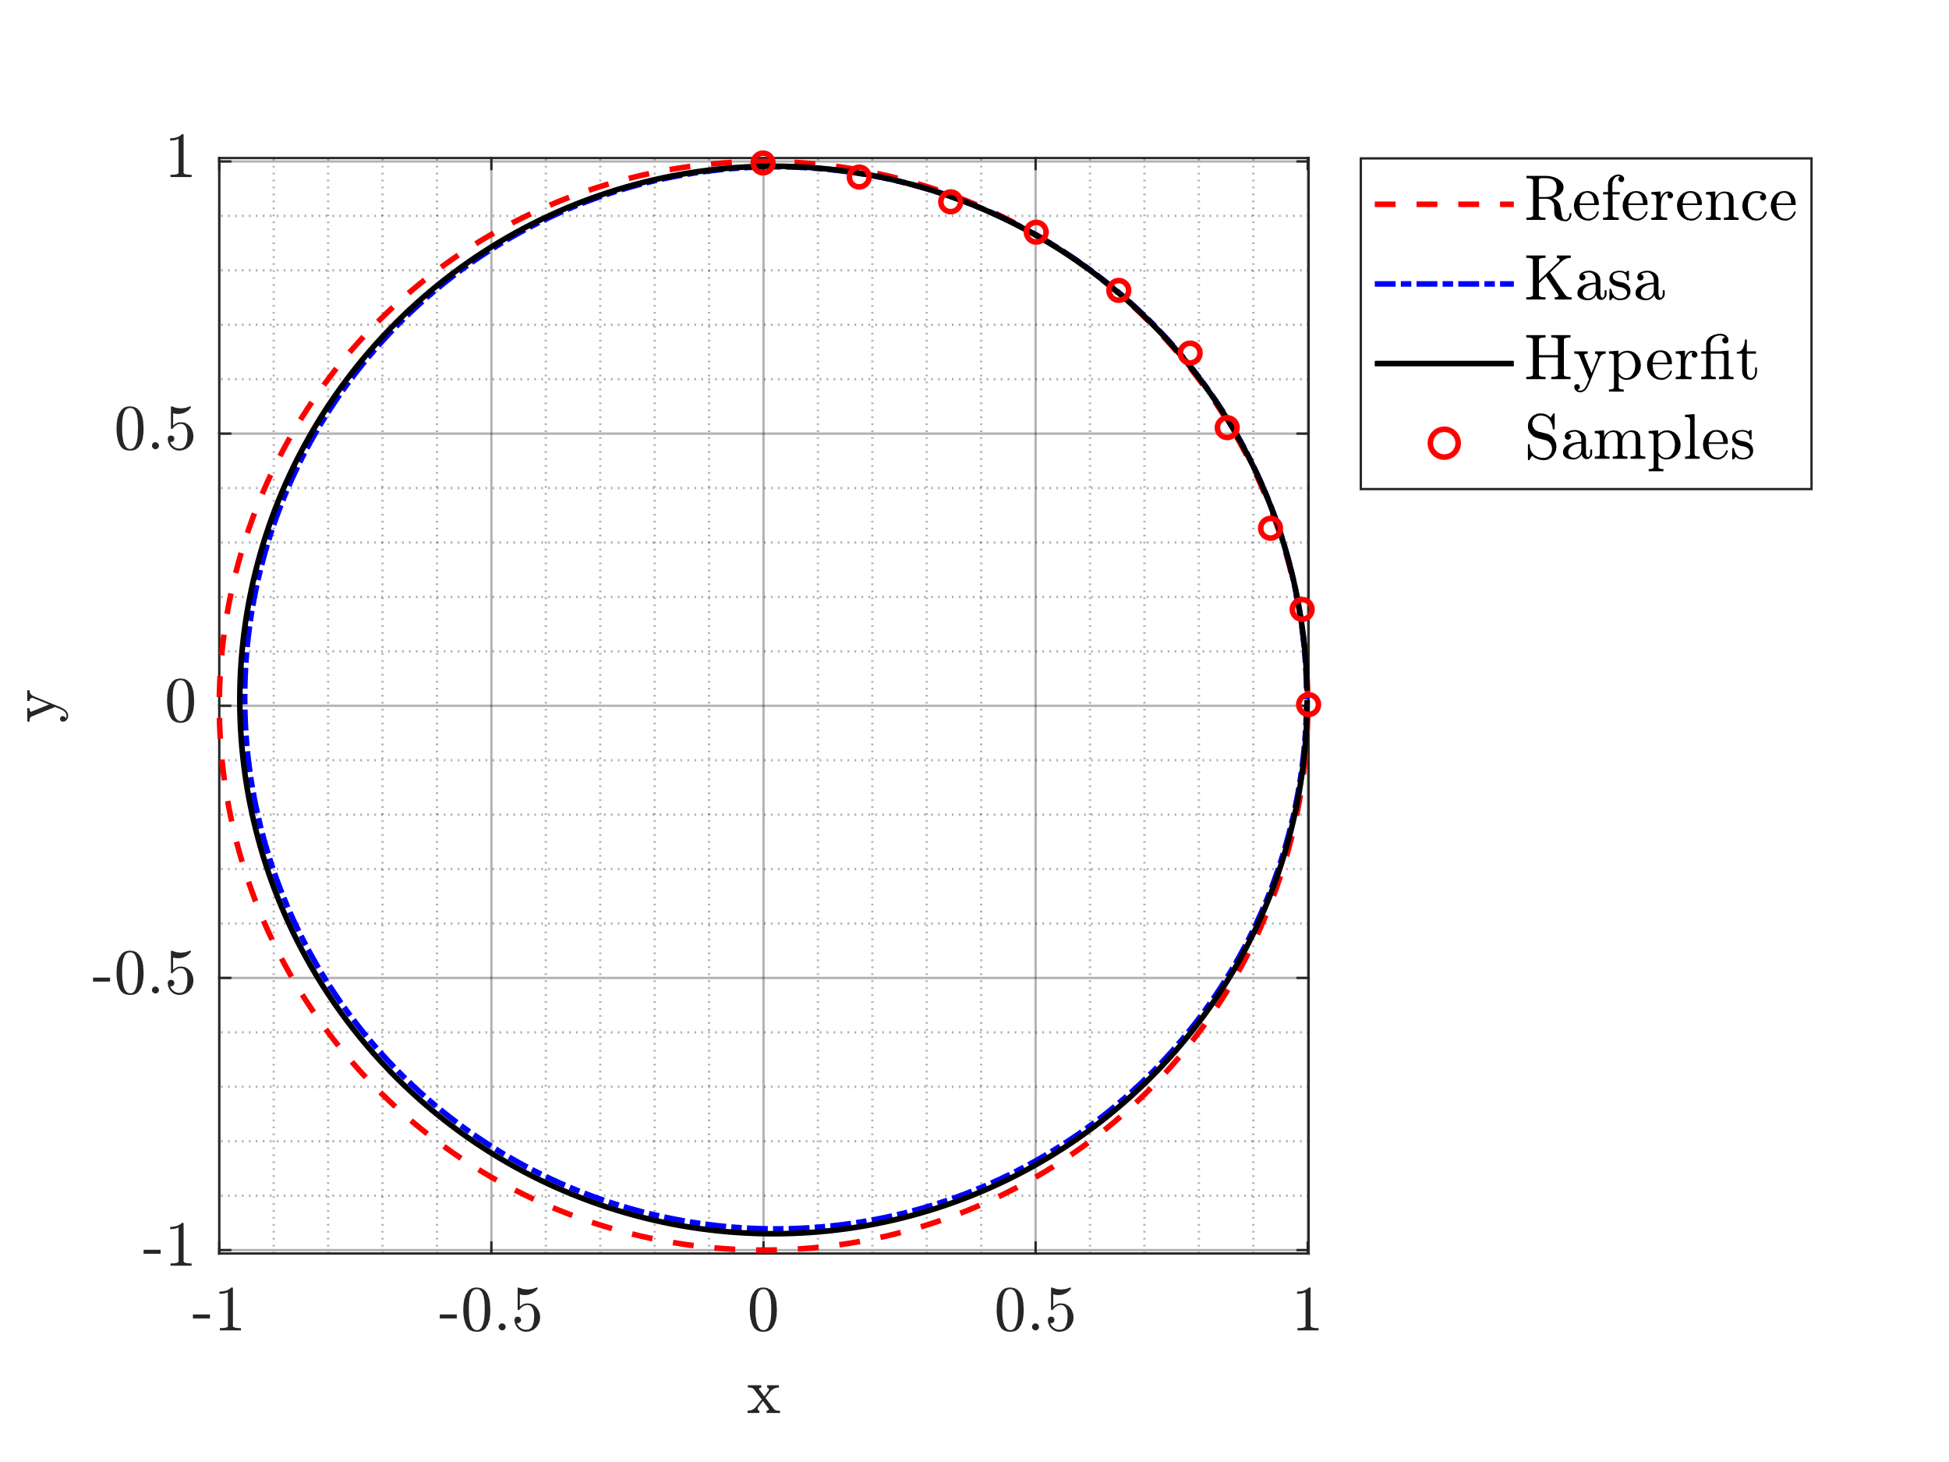
The Improved Method
Same process as before, but different circle fitting algorithm
Hyper-accurate circle fit (“Hyperfit”) by A. Al-Sharadqah and N. Chernov
Reduces fitting error when arc span is small relative to noise

Slide 7
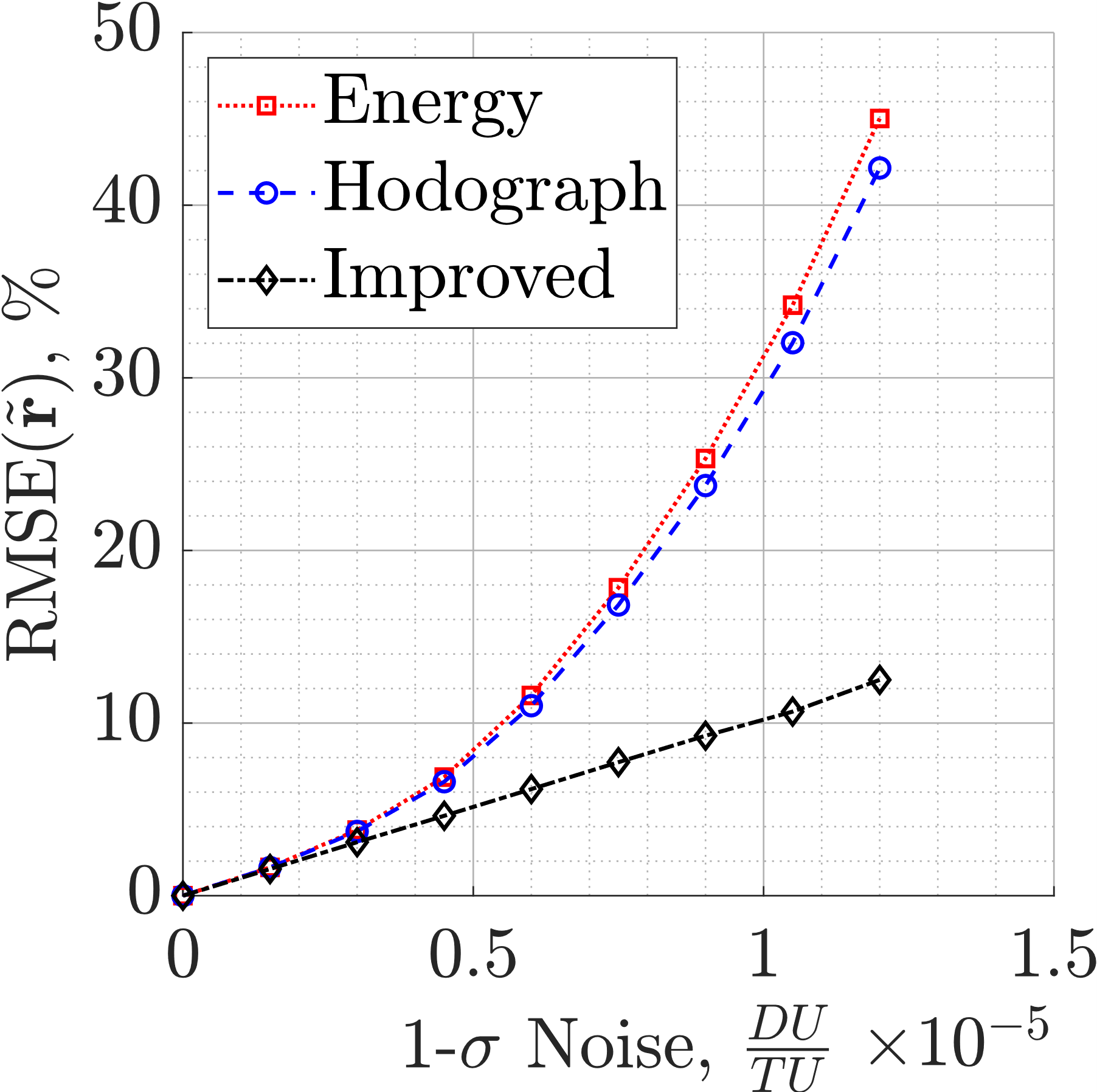
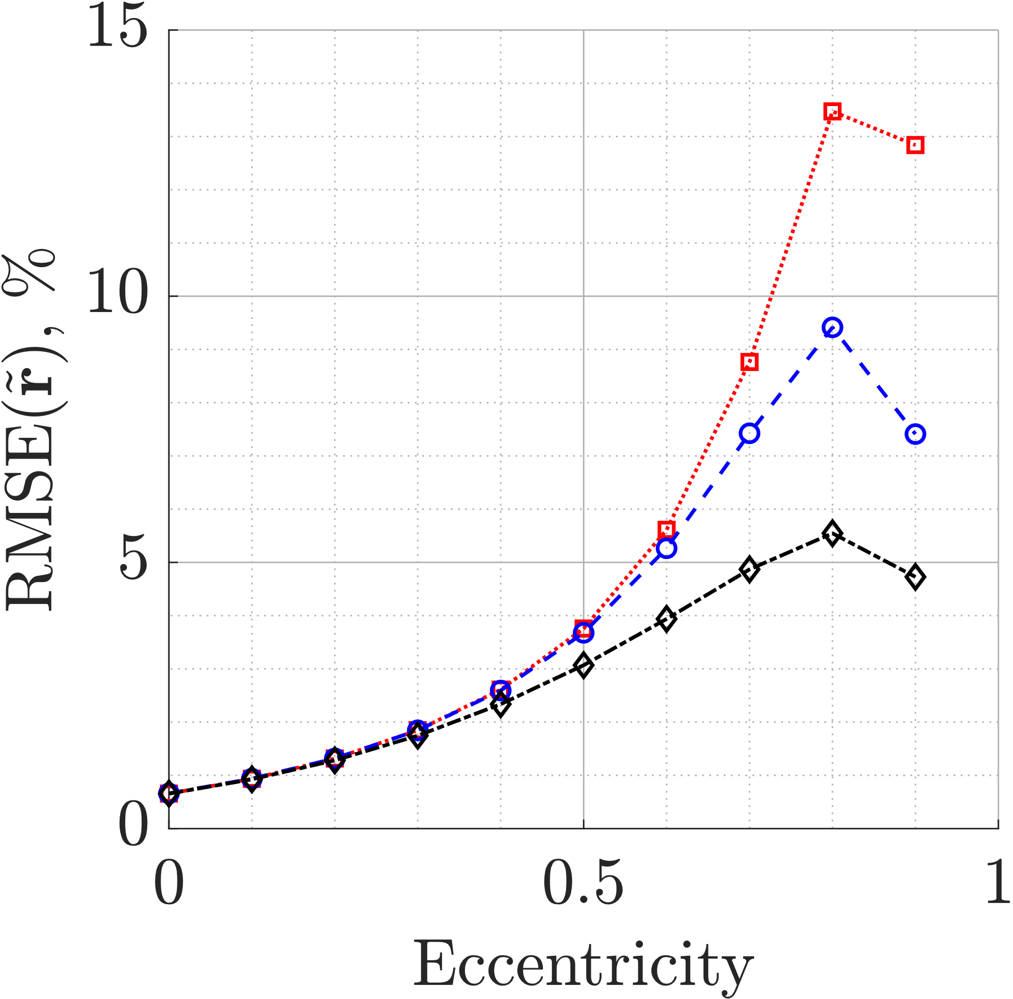
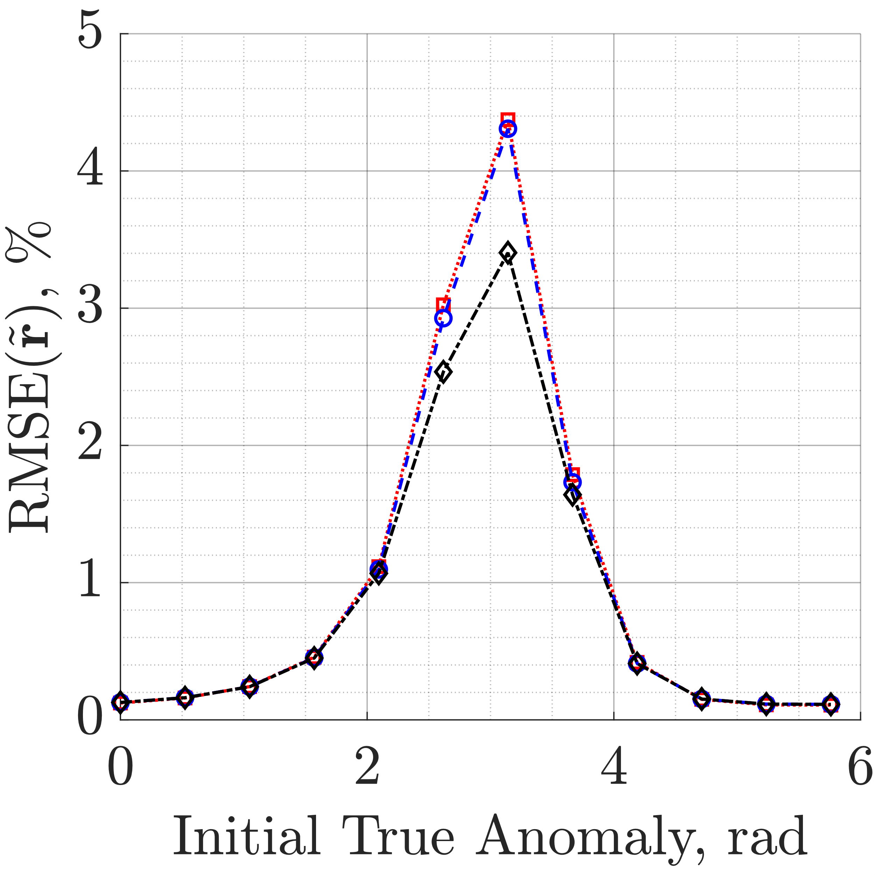
Accuracy
Improved Method > Hodograph Method > Energy Method

Slide 8
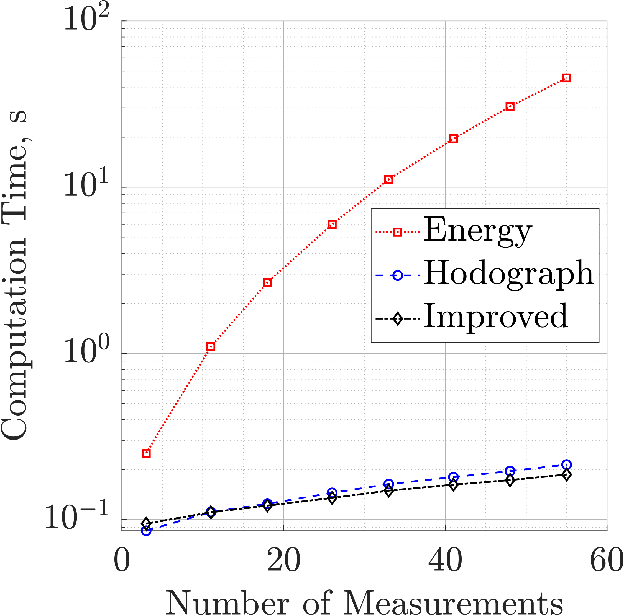
Computation Speed
Improved Method = Hodograph Method > Energy Method

Slide 9
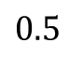
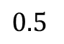
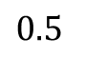
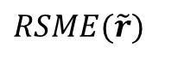
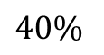
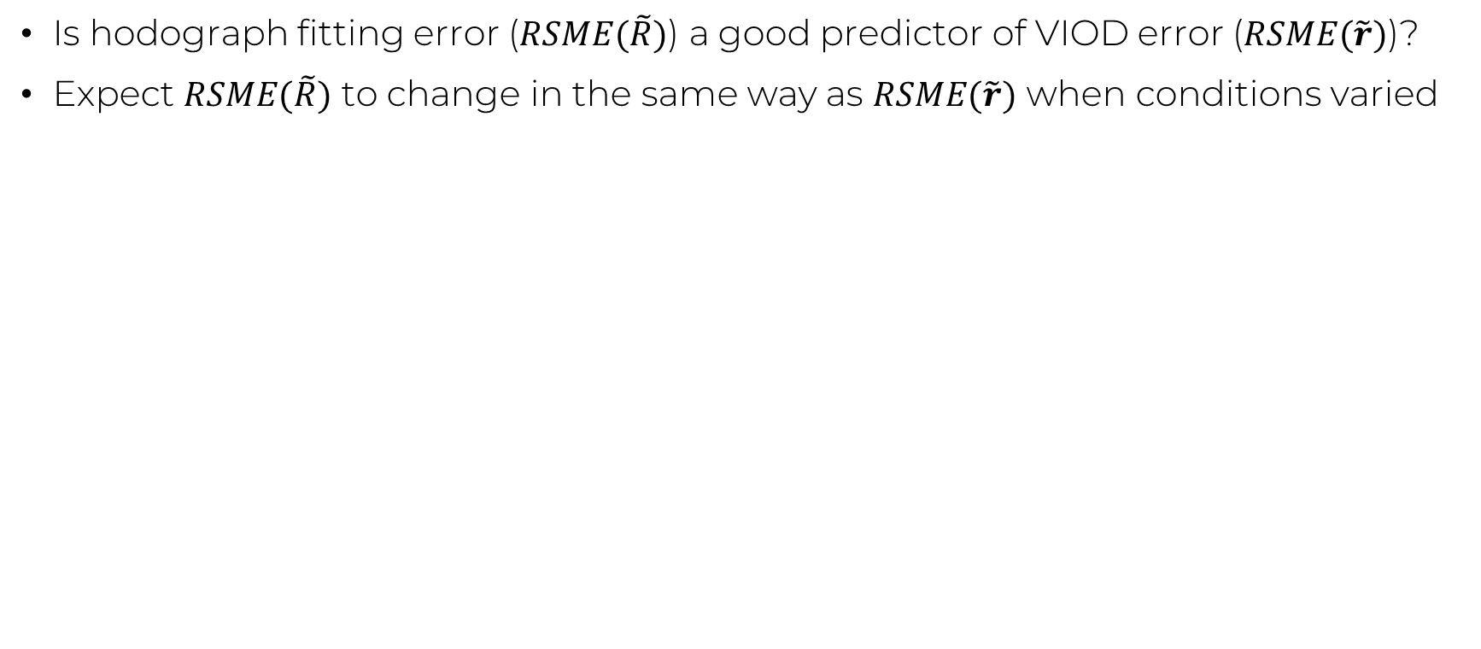
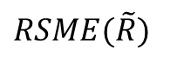
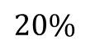
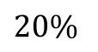
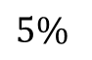
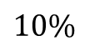
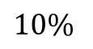
Modeling VIOD Error using the Hodograph
Is hodograph fitting error ($RSME(\tilde{R})$) a good predictor of VIOD error ($RSME(\tilde{r})$)?
Expect $RSME(\tilde{R})$ to change in the same way as $RSME(\tilde{r})$ when conditions varied
Case 1
Case 2
Case 3
$RSME(\tilde{R})$
$$5\%$$
$$10\%$$
$$20\%$$
$RSME(\tilde{r})$
$$10\%$$
$$20\%$$
$$40\%$$
Ratio
$$0.5$$
$$0.5$$
$$0.5$$
Constant

Slide 10
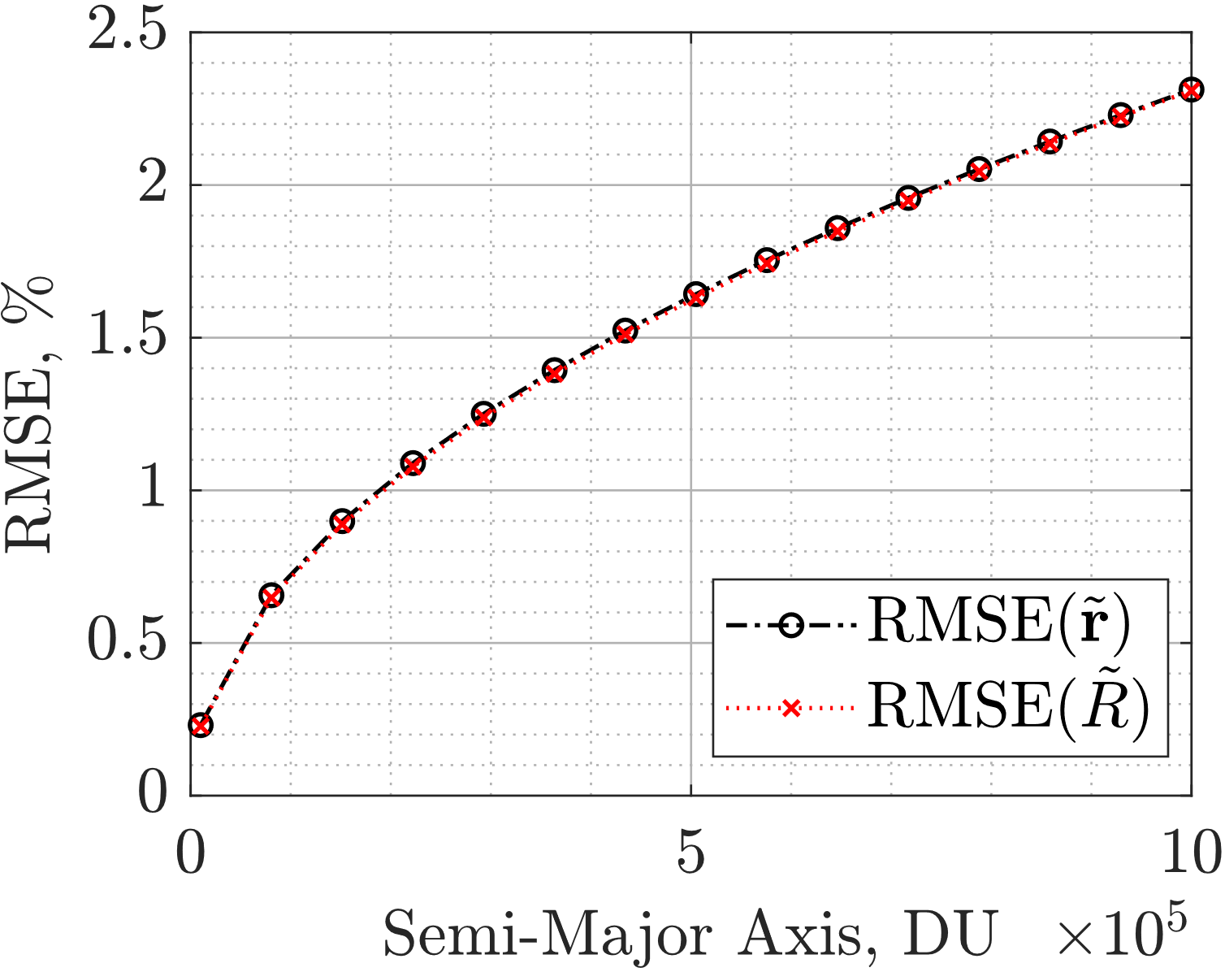
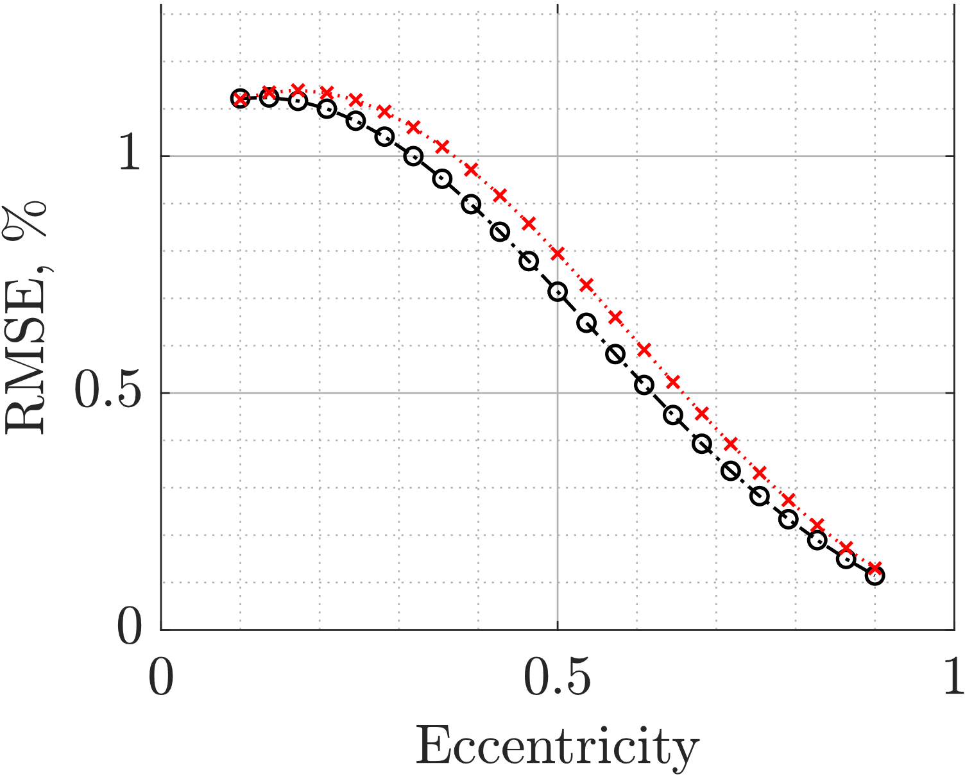
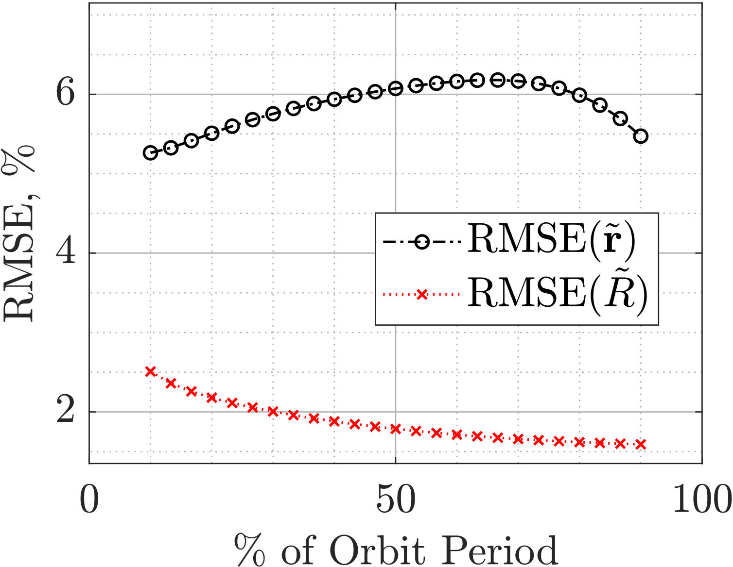
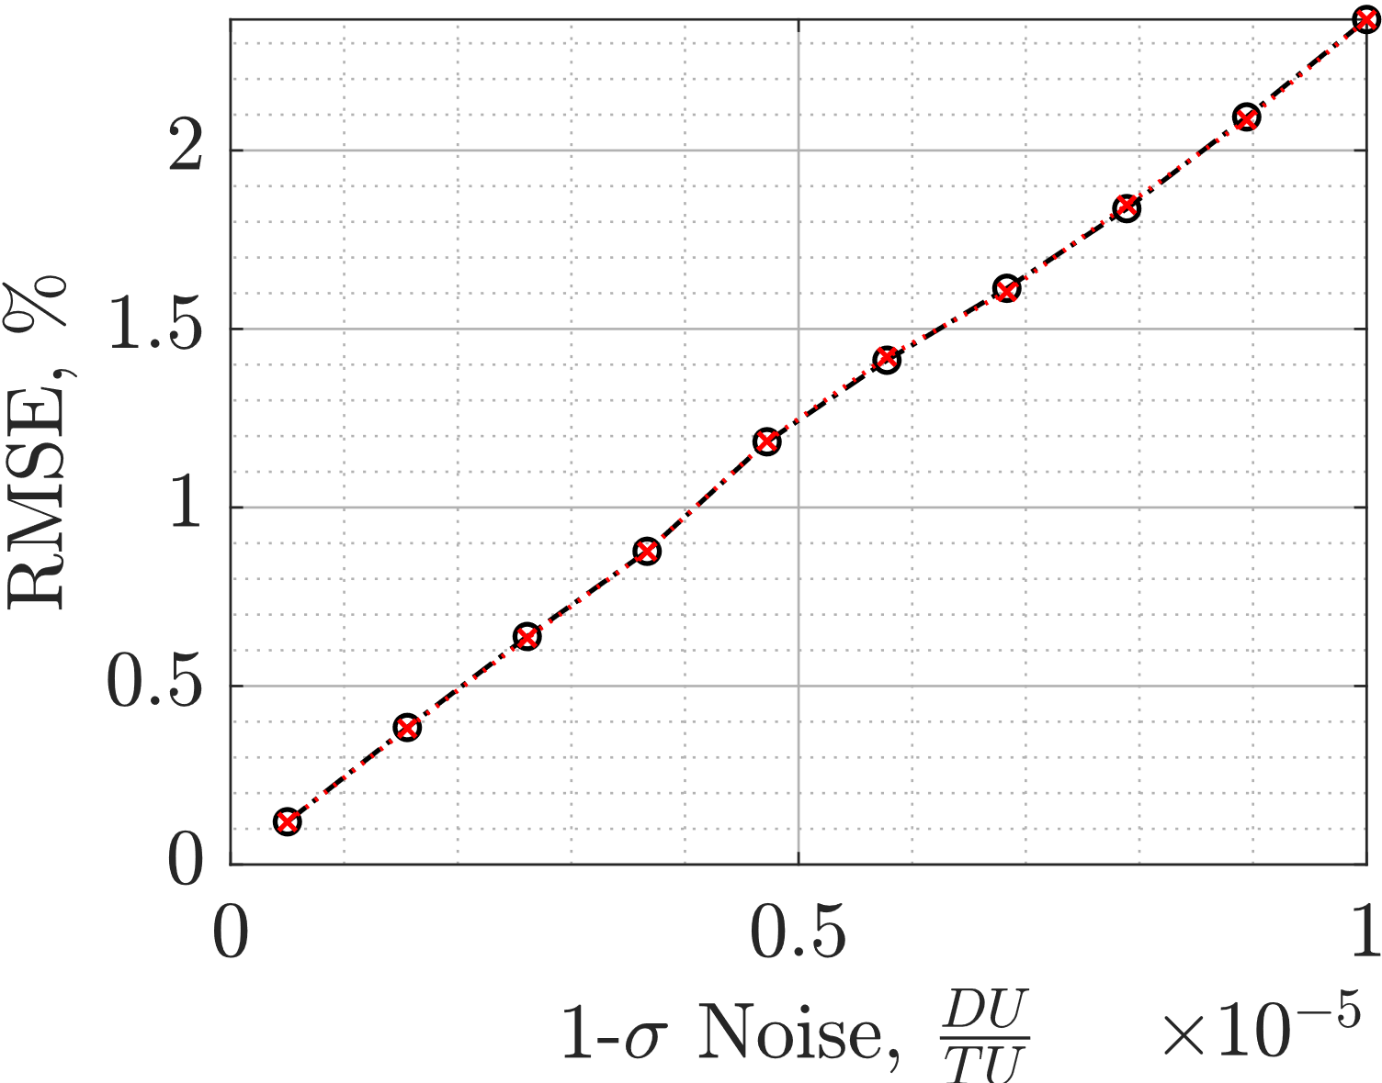
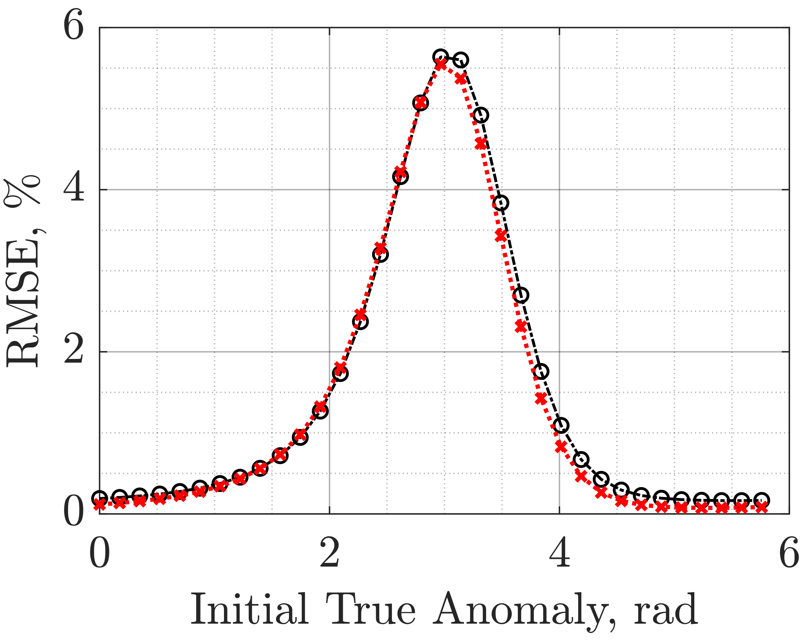
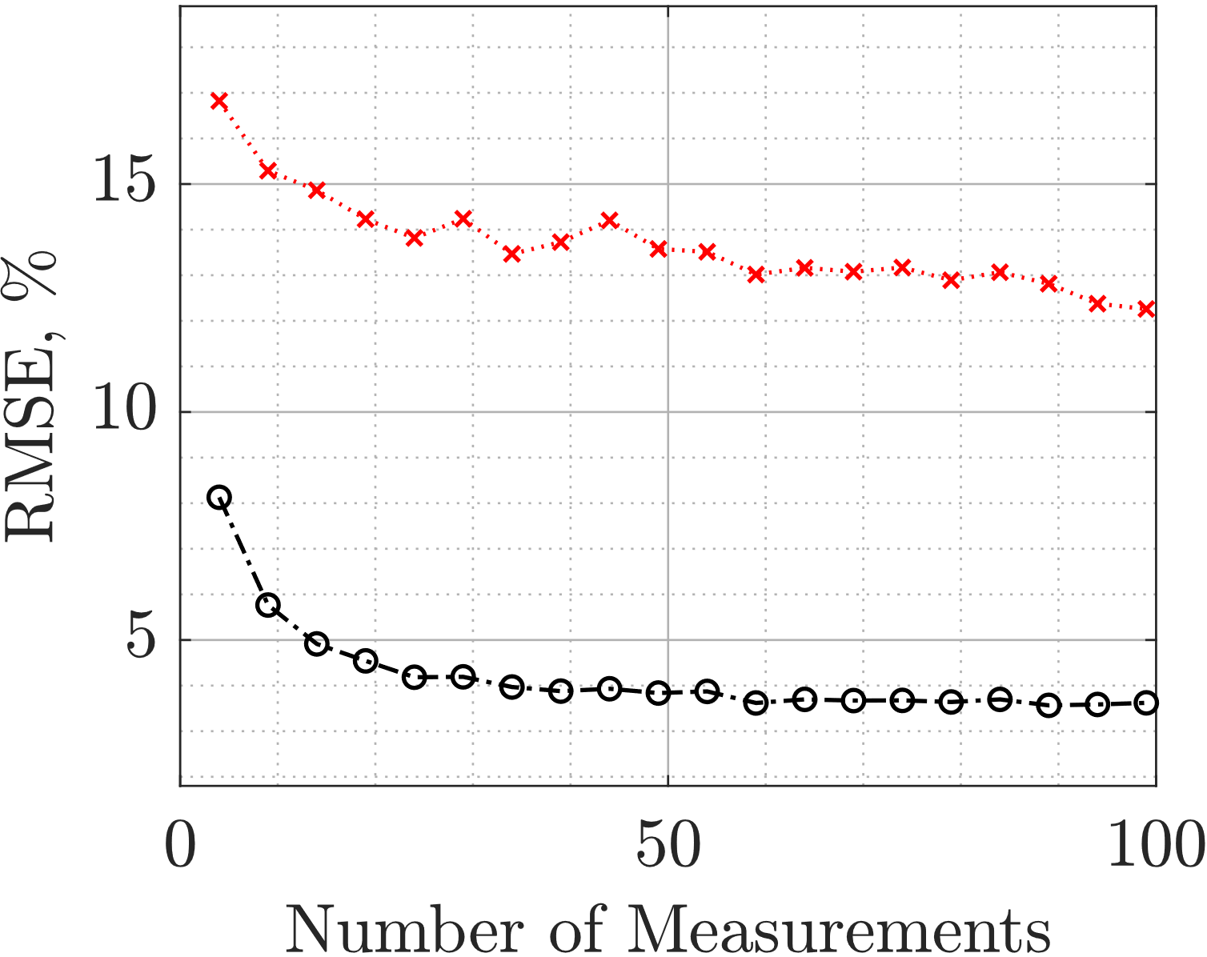
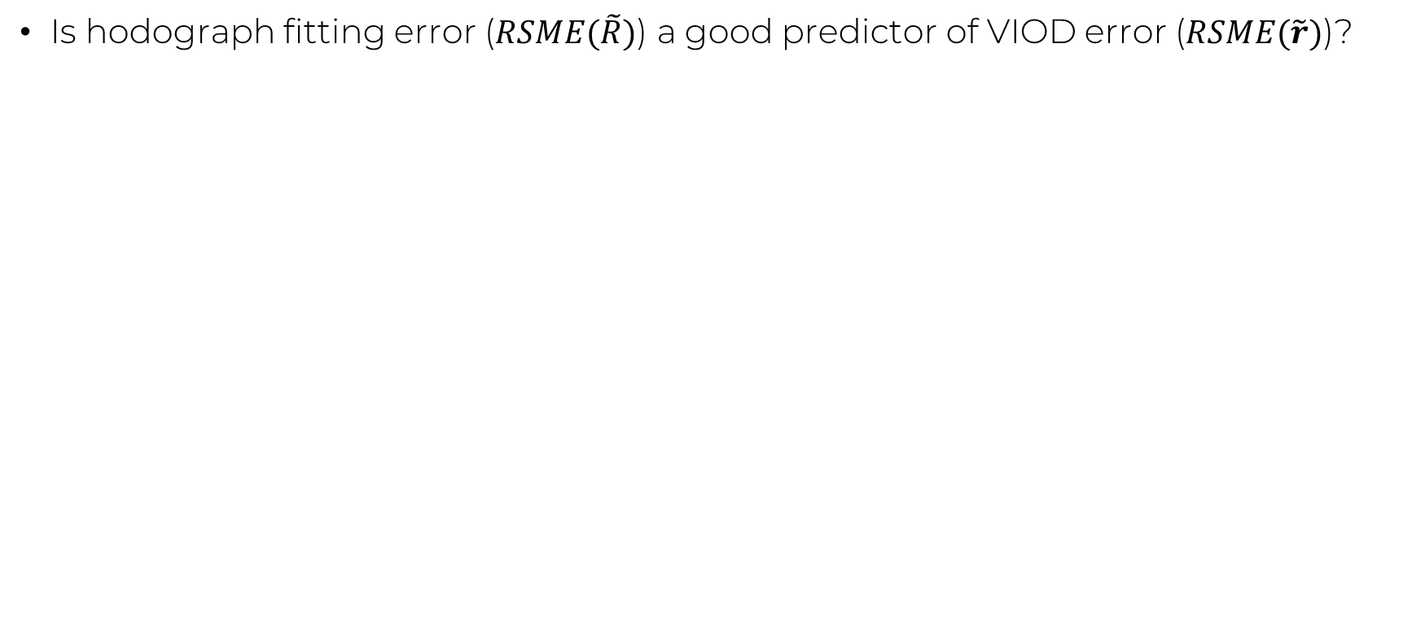
Modeling VIOD Error using the Hodograph
Is hodograph fitting error ($RSME(\tilde{R})$) a good predictor of VIOD error ($RSME(\tilde{r})$)?

Slide 11
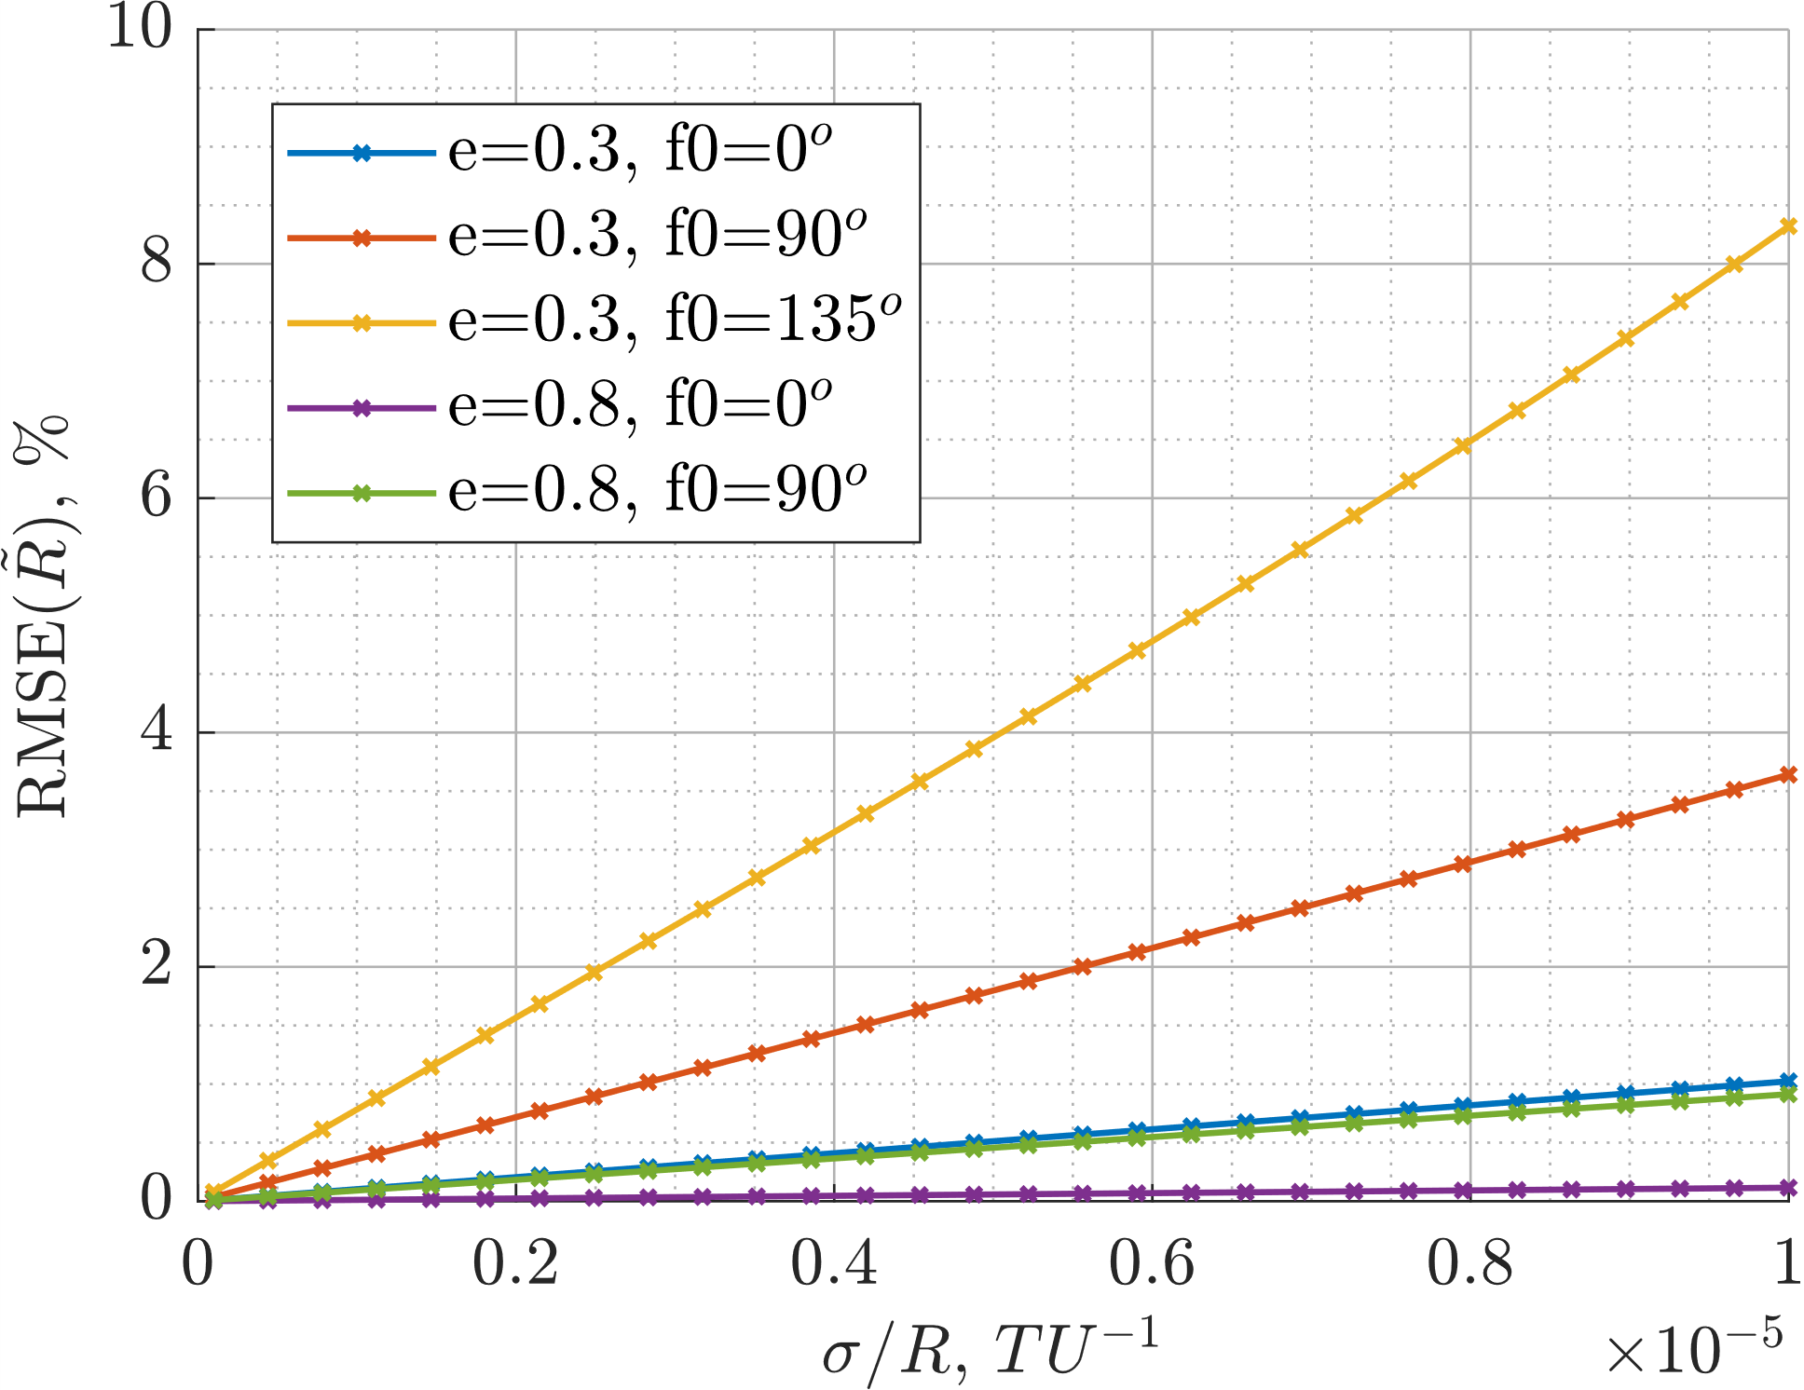
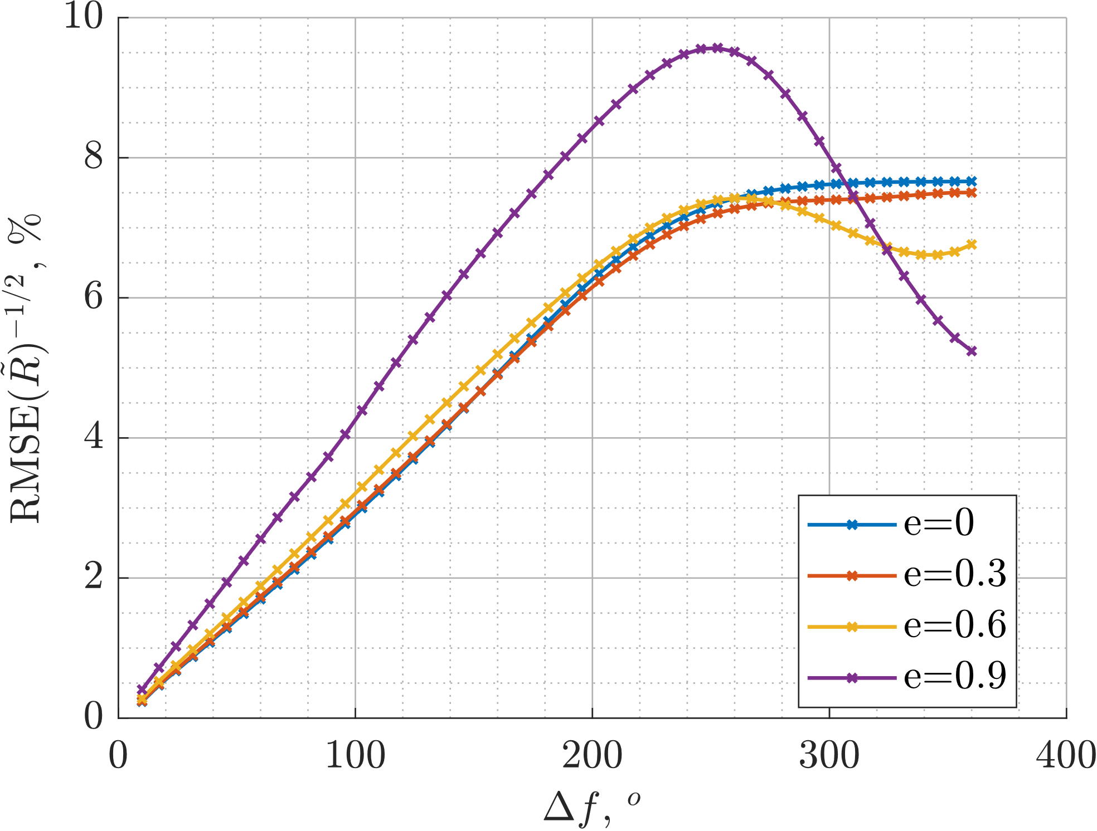
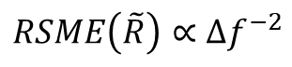
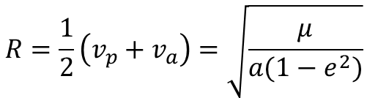
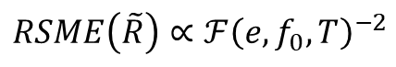
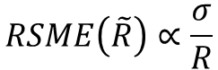
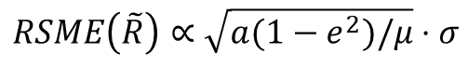
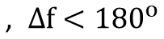
Error Models
$$R=\frac{1}{2}\left(v_{p}+v_{a}\right)=\sqrt{\frac{μ}{a(1−e^{2})}}$$
$$RSME\left(\tilde{R}\right)∝\frac{σ}{R}$$
$$RSME\left(\tilde{R}\right)∝\sqrt{a(1−e^{2})/μ}⋅σ$$
$$RSME\left(\tilde{R}\right)∝Δf^{−2}$$
$$\text{, }Δf<{180}^{o}$$
Find $Δf$ using Kepler’s equation, $Δf=ℱ(e,f_{0},T)$
$$RSME\left(\tilde{R}\right)∝ℱ{\left(e,f_{0},T\right)}^{−2}$$

Slide 12
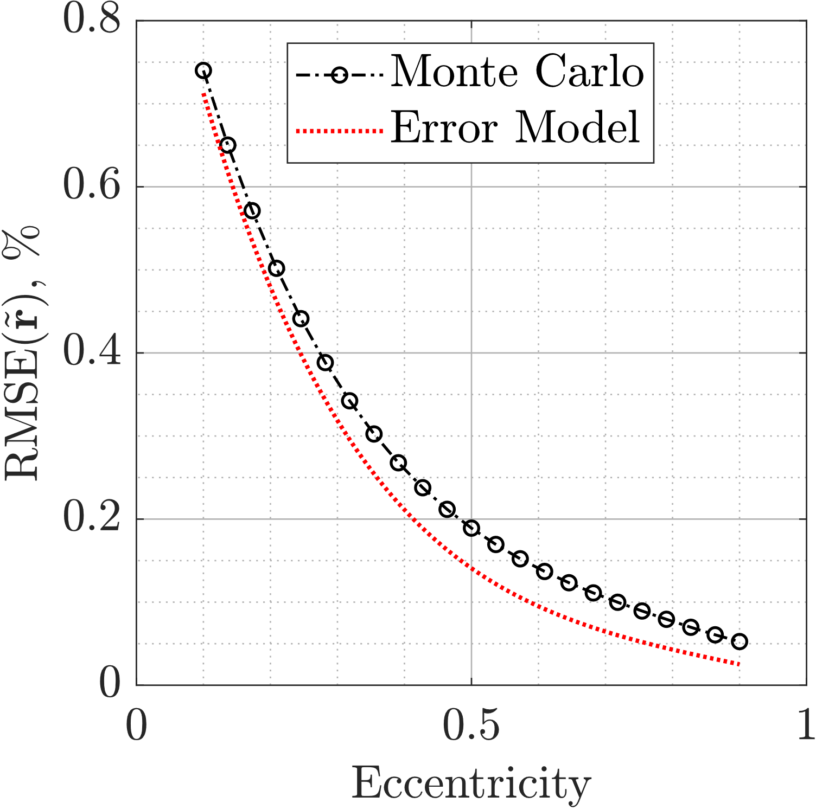
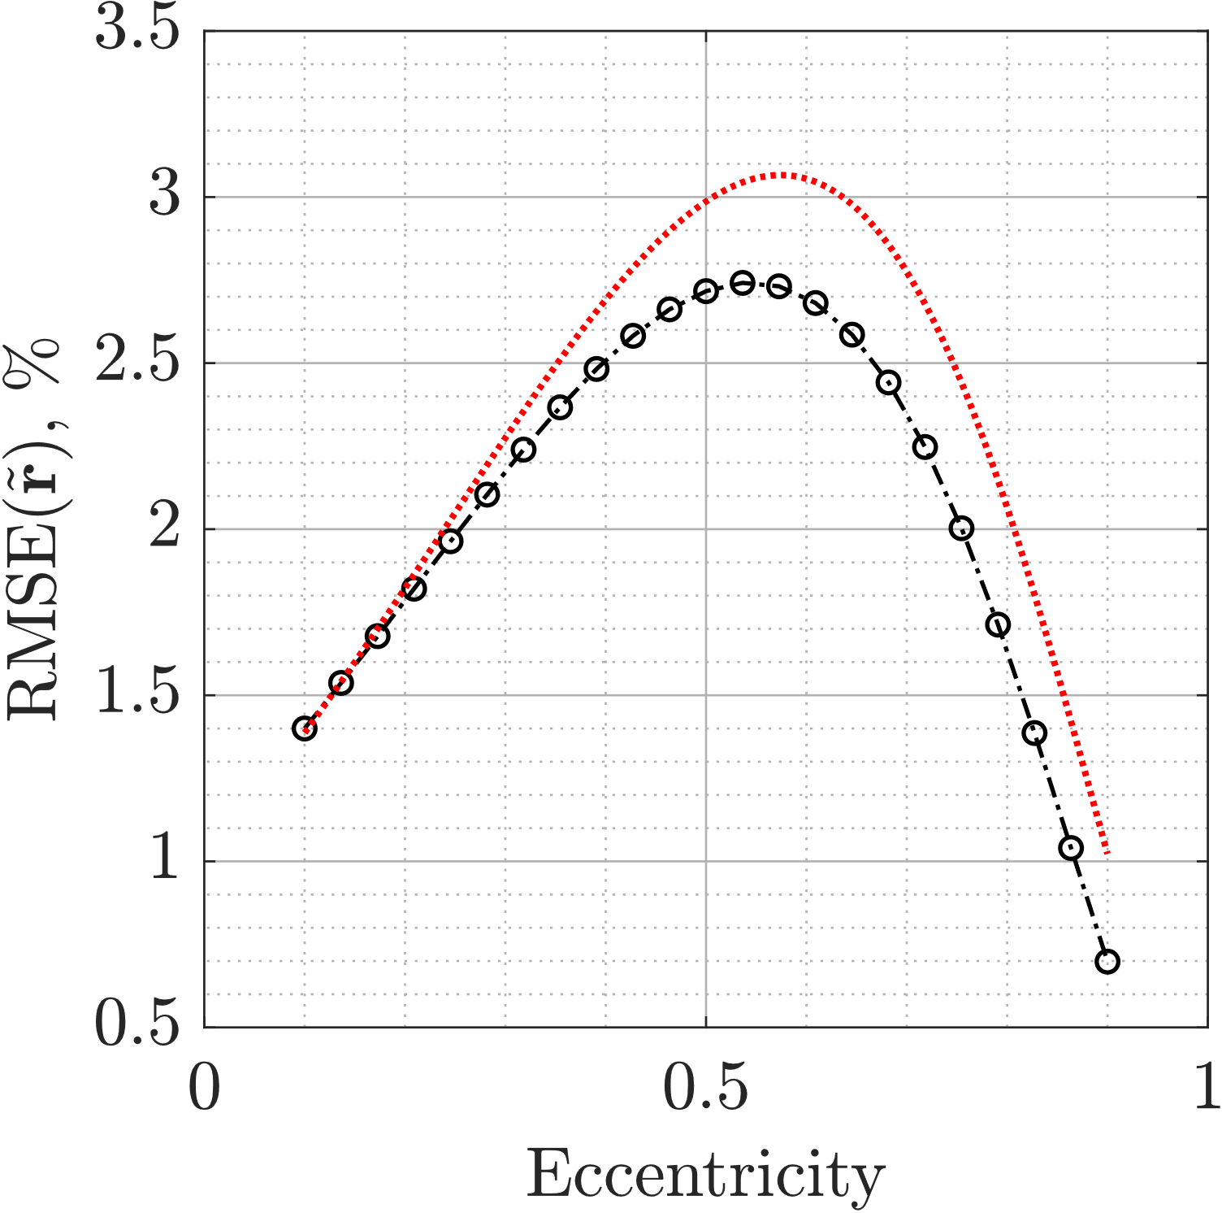
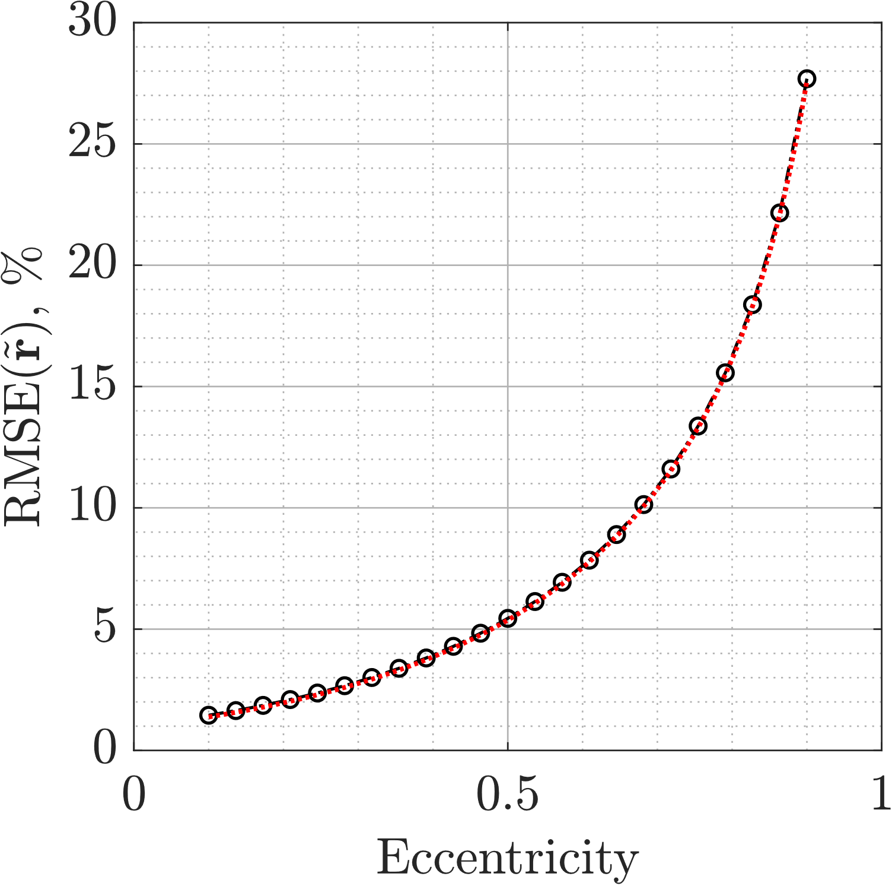
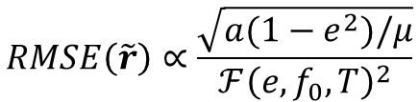
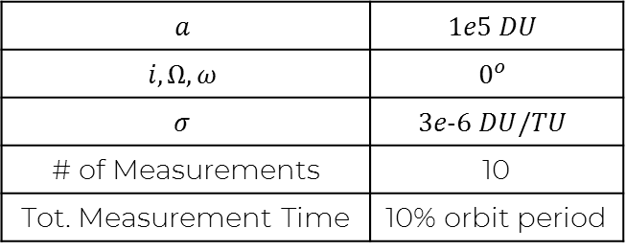
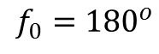
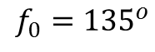
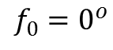
Validation: Eccentricity
$$a$$ | $$1e5 DU$$
$$i, Ω, ω$$ | $$0^{o}$$
$$σ$$ | $$3e\text{-}6 DU/TU$$
# of Measurements | 10
Tot. Measurement Time | 10% orbit period
$$RMSE\left(\tilde{r}\right)∝\frac{\sqrt{a(1−e^{2})/μ}}{ℱ{\left(e,f_{0},T\right)}^{2}}$$
$$f_{0}=0^{o}$$
$$f_{0}={135}^{o}$$
$$f_{0}={180}^{o}$$

Slide 13
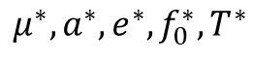




Example: Predicting VIOD Error
Calculate VIOD error of any orbit using Monte Carlo simulations
Use analytic error model to convert to desired orbit
$$RMSE{\left(\tilde{r}\right)}^{∗}$$
$$\frac{RMSE(\tilde{r})}{RMSE{\left(\tilde{r}\right)}^{∗}}=\frac{σ}{σ^{∗}}⋅\frac{\sqrt{a\left(1−e^{2}\right)/μ}}{\sqrt{a^{∗}\left(1−{e^{∗}}^{2}\right)/μ^{∗}}}⋅{\left[\frac{ℱ\left(e^{∗},f_{0}^{∗},T^{∗}\right)}{ℱ(e,f_{0},T)}\right]}^{2}$$
$$μ^{∗},a^{∗},e^{∗},f_{0}^{∗},T^{∗}$$
$$RMSE(\tilde{r})$$
$$μ,a,e,f_{0},T$$
* Denotes reference orbit

Slide 14


Example: Predicting VIOD Error Cont’d
Reference Orbit (RMSE=7.23%):
$μ^{∗}=1\frac{DU^{3}}{TU^{2}}$ , $a^{∗}=1×{10}^{5} DU$
$e^{∗}=0.5$ , $f_{0}^{∗}={90}^{o}$
$σ^{∗}=3×{10}^{−5}\frac{DU}{TU}$ , $T^{∗}=0.1∗2π\sqrt{\frac{a^{∗^{3}}}{{μ^{∗}}^{3}}}$
Target Orbit:
$μ=1.327×{10}^{11}\frac{km^{3}}{s^{2}}$ , $a=15.53 AU$
$e=0.9356$ , $f_{0}={170}^{o}$
$σ=5 m/s$ , $T=1.932×{10}^{9} s$
Predicted Error: 15.39%
Monte Carlo Error: 15.01%

Slide 15
Conclusions and Future Work
Improved hodograph-based VIOD algorithm
Developed & validated error model for hodograph-based VIOD
---
Accommodate changes in other parameters
e.g., the measurement duration and the number of measurements
Eliminate need for the error of a reference orbit
Generate error bounds from VIOD results

Slide 16
Thank you!

Slide 17
















Questions

Slide 18
Backup Slides

Slide 19
Contributions
Contribution 1
Accuracy improvement to an existing VIOD algorithm
Contribution 2
New analytic error model for hodograph-based VIOD algorithms
Demonstrated error model accuracy
Error prediction example using analytic model

Slide 20


















The Energy Method (EM)
$$r_{u_{i}}=\left(u_{i}u_{i}^{T}\right)r_{i}$$
$$α_{i}=\frac{μ}{\left\|r_{i}\right\|}$$
$$β_{i}=γ_{i}\frac{μ}{\left\|r_{i}\right\|}\frac{\left\|r_{u_{i}}\right\|}{h}$$
$$r_{w_{i}}=\left(w_{i}w_{i}^{T}\right)r_{i}$$
$$z_{i}=\frac{w_{i}}{\left\|v_{i}\right\|}$$
$$v={\left[μ\left(\frac{2}{r}−\frac{1}{a}\right)\right]}^{1/2}$$
$$μe=v_{i}×h−\frac{μ}{\left\|r_{i}\right\|}r_{i}$$
$$μ\frac{e}{h}=\left\|v_{i}\right\|w_{i}−\frac{μ}{\left\|r_{i}\right\|}(\frac{r_{u_{i}}}{h}+z_{i})$$
$$−\frac{μ}{a}=\frac{{\left\|v_{i}\right\|}^{2}}{2}−\frac{μ}{\left\|r_{i}\right\|}=\frac{{\left\|v_{i}\right\|}^{2}}{2}−α_{i}$$
$$α_{i}z_{i}+β_{i}u_{i}−α_{j}z_{j}−β_{j}u_{j}$$
$$α_{i}−α_{j}=\frac{{\left\|v_{i}\right\|}^{2}}{2}−\frac{{\left\|v_{j}\right\|}^{2}}{2}$$
$$=\left\|v_{i}\right\|w_{i}−\left\|v_{j}\right\|w_{j}$$
J. A. Christian and C. L. Hollenberg, “Initial Orbit Determination from Three Velocity Vectors,” Journal of Guidance, Control, and Dynamics
$$h=\left\|r_{i}\right\|\left\|v_{i}\right\|{\left[1+{\left(\frac{β_{i}\left\|v_{i}\right\|}{α_{i}}\right)}^{2}\right]}^{−1/2}$$
$$r_{w_{i}}=hz_{i}$$
$$\left\|r_{i}\right\|=\frac{μ}{α_{i}}$$
$$r_{u_{i}}=\frac{β_{i}h\left\|r_{i}\right\|}{μ}u_{i}$$
$$r_{i}=r_{u_{i}}+r_{w_{i}}$$

Slide 21

Simulation and Error Evaluation
Simulate two-body motion, measure velocities over 10% of orbit
Obtain 20 velocity vectors $\{v_{1}, …, v_{20}\}$ and corresponding positions $\{r_{1}, …, r_{20}\}$
$a=1e5 DU, e=0.5, i=Ω=ω=0^{o},f_{0}={160}^{o}, σ=3e\text{-}6 DU/TU$
Apply independent sensor noise to each measurement
Obtain perturbed velocities ${\tilde{v}}_{i}=v_{i}+η_{i}$
Perform VIOD using 3000-sample Monte Carlo simulations
Calculate relative root-mean-square error of the first position
$RMSE\left(\tilde{r}\right)=\sqrt{ \frac{1}{n} \sum_{i=1}^{n}{ \frac{\left\|{\tilde{r}}_{i}−r\right\|}{\left\|r\right\|}}}$

Slide 22


Validation: Semi-major Axis
$$RMSE\left(\tilde{r}\right)∝\sqrt{a(1−e^{2})/μ}$$

Slide 23


Validation: Sensor Noise
$$RMSE\left(\tilde{r}\right)∝σ$$

Slide 24







Validation: Initial True Anomaly
$$a$$ | $$1e5 DU$$
$$i, Ω, ω$$ | $$0^{o}$$
$$σ$$ | $$3e\text{-}6 DU/TU$$
# of Measurements | 10
Tot. Measurement Time | 10% orbit period
$$RMSE\left(\tilde{r}\right)∝ℱ{\left(e,f_{0},T\right)}^{−2}$$
$$e=0.1$$
$$e=0.5$$
$$e=0.9$$

